Slide 1
TEST AUTOMATION

Slide 2

What is Automation Testing?
Manual Testing is performed by a human sitting in front of a computer carefully executing the test steps.

Slide 3

Automation Testing means using an automation tool to execute your test case suite.
The automation software can also enter test data into the System Under Test, compare expected and actual results and generate detailed test reports.

Slide 4

Using a test automation tool, it's possible to record this test suite and re-play it as required.
Once the test suite is automated, no human intervention is required.
The goal of Automation is to reduce the number of test cases to be run manually and not to eliminate Manual Testing altogether.

Slide 5
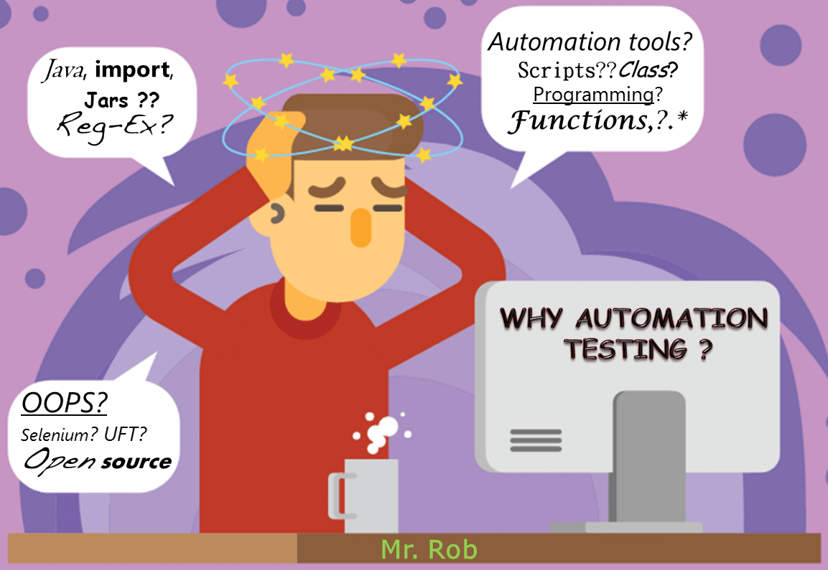
Why Automated Testing?

Slide 6

Manual Testing of all workflows, all fields, all negative scenarios is time and money consuming
AUTOMATİON DOES NOT REQUİRE HUMAN İNTERVENTİON. YOU CAN RUN AUTOMATED TEST UNATTENDED (OVERNİGHT)
AUTOMATİON İNCREASES THE SPEED OF TEST EXECUTİON
AUTOMATİON HELPS İNCREASE TEST COVERAGE
MANUAL TESTİNG CAN BECOME BORİNG AND HENCE ERROR-PRONE
IT İS DİFFİCULT TO TEST FOR MULTİLİNGUAL SİTES MANUALLY

Slide 7
Which Test Cases to Automate?
High Risk - Business Critical test cases
Test cases that are repeatedly executed
Test Cases that are very tedious or difficult to perform manually
Test Cases which are time-consuming

Slide 8
The following category of test cases are not suitable for automation
Test Cases that are newly designed and not executed manually at least once
Test Cases for which the requirements are frequently changing
Test cases which are executed on an ad-hoc basis.

Slide 9
Automated Testing Process
Test Tool Selection
Define Scope of Automation
Planning Design and Development
Test Execution
Maintenance

Slide 10
Test tool selection
Test Tool selection largely depends on the technology the Application Under Test is built on.
Define the scope of Automation
The scope of automation is the area of your Application Under Test which will be automated.

Slide 11
Planning, Design, and Development
During this phase, you create an Automation strategy & plan
Test Execution
Automation Scripts are executed during this phase. The scripts need input test data before there are set to run. Once executed they provide detailed test reports.
Maintenance
As new functionalities are added to the System Under Test with successive cycles, Automation Scripts need to be added, reviewed and maintained for each release cycle.
Maintenance becomes necessary to improve the effectiveness of Automation Scripts.

Slide 12
Advantages of test automation include:
More tests can be run per build
The possibility to create tests that cannot be done manually (real-time, remote, parallel tests)
Tests can be more complex
Tests run faster
Tests are less subject to operator error
More effective and efficient use of testing resources
Quicker feedback regarding software quality
Improved system reliability(e.g., repeatability, consistency)
Improved consistency of tests

Slide 13
Disadvantages of test automation include:
Additional costs are involved
Initial investment to setup TAS
Requires additional technologies
Team needs to have development and automation skills
On-going TAS maintenance requirement
Can distract from testing objectives, e.g., focusing on automating tests cases at the expense of executing tests
Tests can become more complex
Additional errors may be introduced by automation

Slide 14
Automation Testing Tools
There are tons of Functional and Regression Testing Tools available in the market. Here are 4 best tools certified by our experts

Slide 15
TRIcentIs
Tricentis is the industry’s #1 Automation Testing platform and is recognized for reinventing software testing for DevOps. Tricentis is the only vendor to achieve “leader” status in all three top analyst reports.
Features:
Risk-based testing
Scriptless end-to-end test automation
Supports API, BI, Mobile, Cross Browser, RPA and other automation testing types
The industry’s most extensive technical support

Slide 16
MABL
mabl delivers scriptless end-to-end test automation, integrated with your delivery pipeline, so you can focus on improving your app.
Features:
Proprietary machine learning models automatically identify and surface application issues
Tests are automatically repaired when UI changes
Automated regression insights on every build

Slide 17
SELENIUM
It is a software testing tool used for Regression Testing. It is an open source testing tool that provides playback and recording facility for Regression Testing. The Selenium IDE only supports Mozilla Firefox web browser.
It provides the provision to export recorded script in other languages like Java, Ruby, RSpec, Python, C#, etc
It can be used with frameworks like JUnit and TestNG
It can execute multiple tests at a time
Autocomplete for Selenium commands that are common
Walkthrough tests
Identifies the element using id, name, X-path, etc.
Store tests as Ruby Script, HTML, and any other format
It provides an option to assert the title for every page
It supports selenium user-extensions.js file
It allows to insert comments in the middle of the script for better understanding and debugging

Slide 18
QTP
QTP is widely used for functional and regression testing, it addresses every major software application and environment. To simplify test creation and maintenance, it uses the concept of keyword driven testing. It allows the tester to build test cases directly from the application.
It is easier to use for a non-technical person to adapt to and create working test cases
It fix defects faster by thoroughly documenting and replicating defects for developer
Collapse test creation and test documentation at a single site
Parameterization is easy than WinRunner
QTP supports .NET development environment
It has better object identification mechanism
It can enhance existing QTP scripts without "Application Under Test" is available, by using the active screen

Slide 19
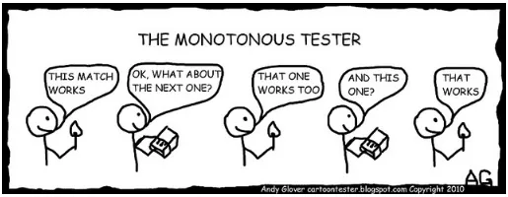

Slide 20
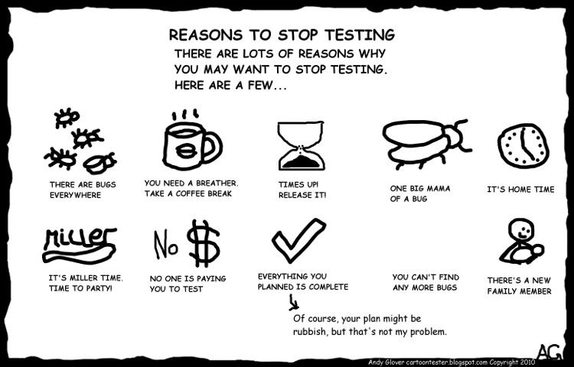
thanks for attention

